Slide 1
HDB Predictions
Brendan, Azri, Zi Chuan

Slide 2
Content Slide
Data Limitations / Assumptions
Main Feature (HDB Price Prediction)
Buyer/Seller Personas
Research
Technical
Retrospective

Slide 3
Data Limitations / Assumptions (2012-21)
Our model best predicts 3 room, 4 room and 5 room flat prices
Biases: Our data set has more 3, 4 and 5 room flats (~90% of data)
Grouping: We grouped outliers in flat size and type into “others”
Other data sources: HDB Resale Price Index, Median Household Income, Domestic Interest Rates

Slide 4
Part 1: Main Feature

Slide 5
The Mission
To enable our agents to walk into a discussion and have a conversation such as
“Your home is a 4 room, premium model in Toa Payoh. Base price in this area is SGD 450,000, +30,000 because near to a MRT, +7,000 as near to a hawker, +3,000 as near to a primary school , +20,000 due to high floor and -30,000 due to 30 years of age. Competitive pricing for your home is SGD 480,000.”
Data driven and confidence inspiring with a consideration for features.

Slide 6
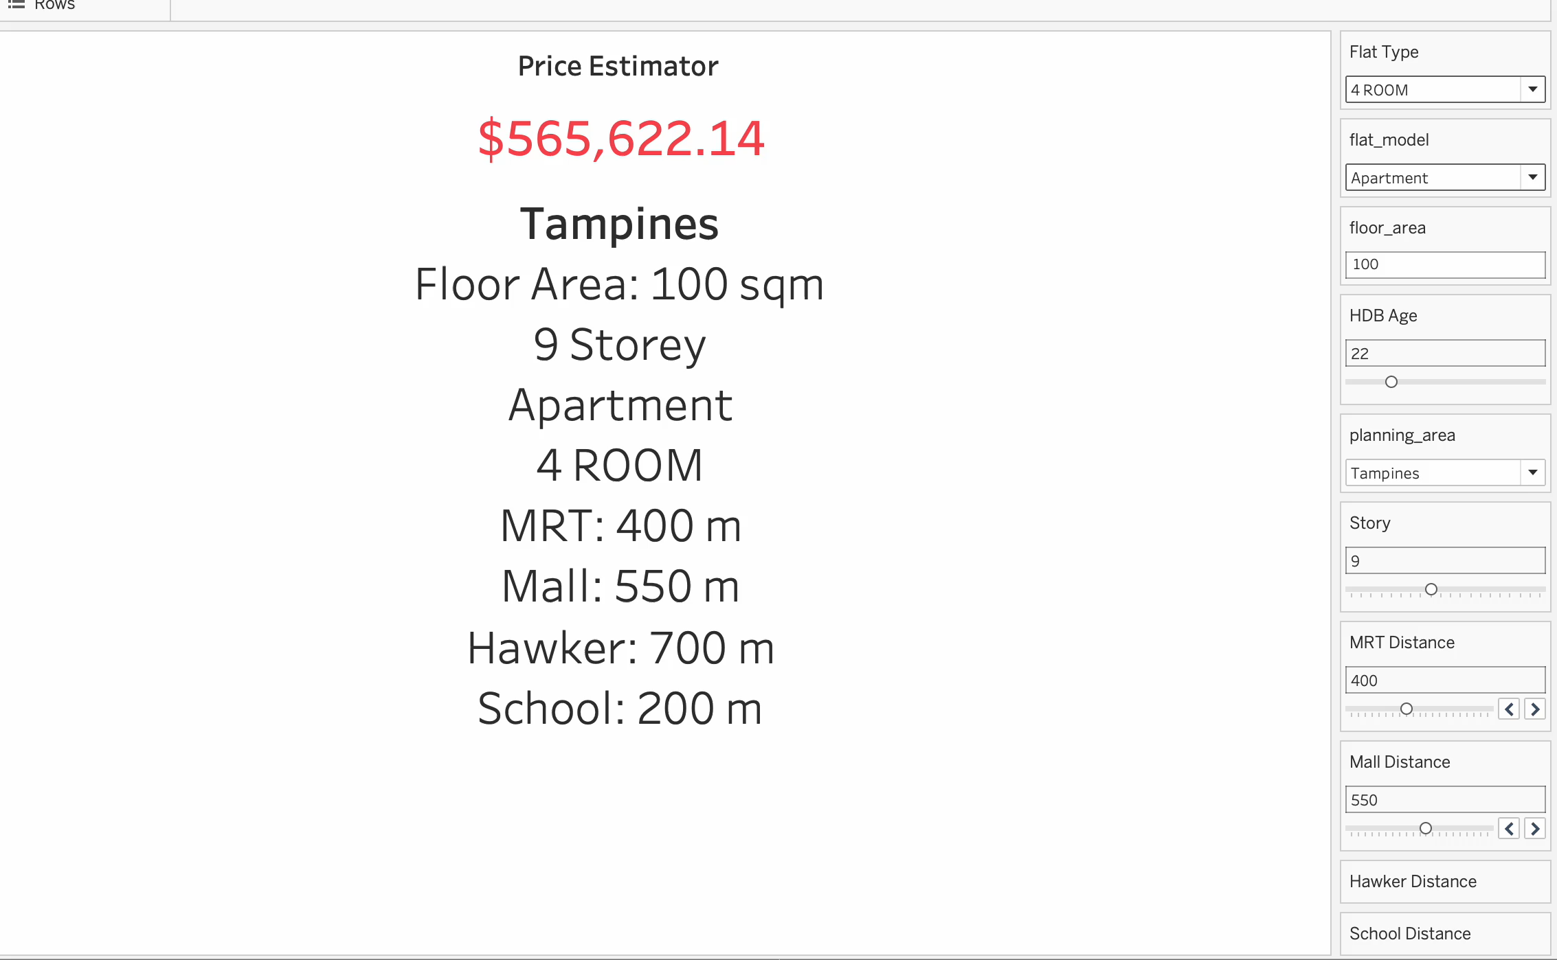

Slide 7
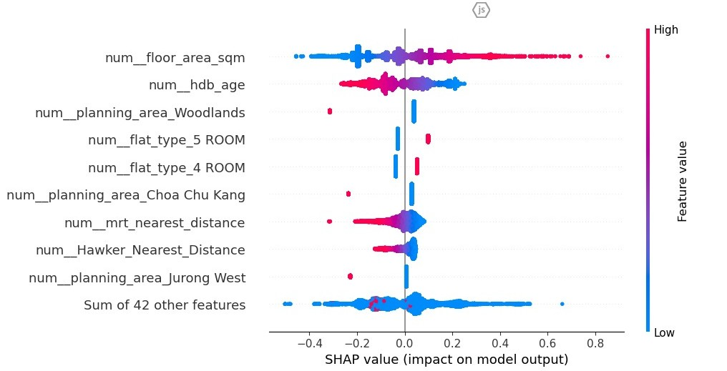
Main Findings (Feature Ranking)

Slide 8
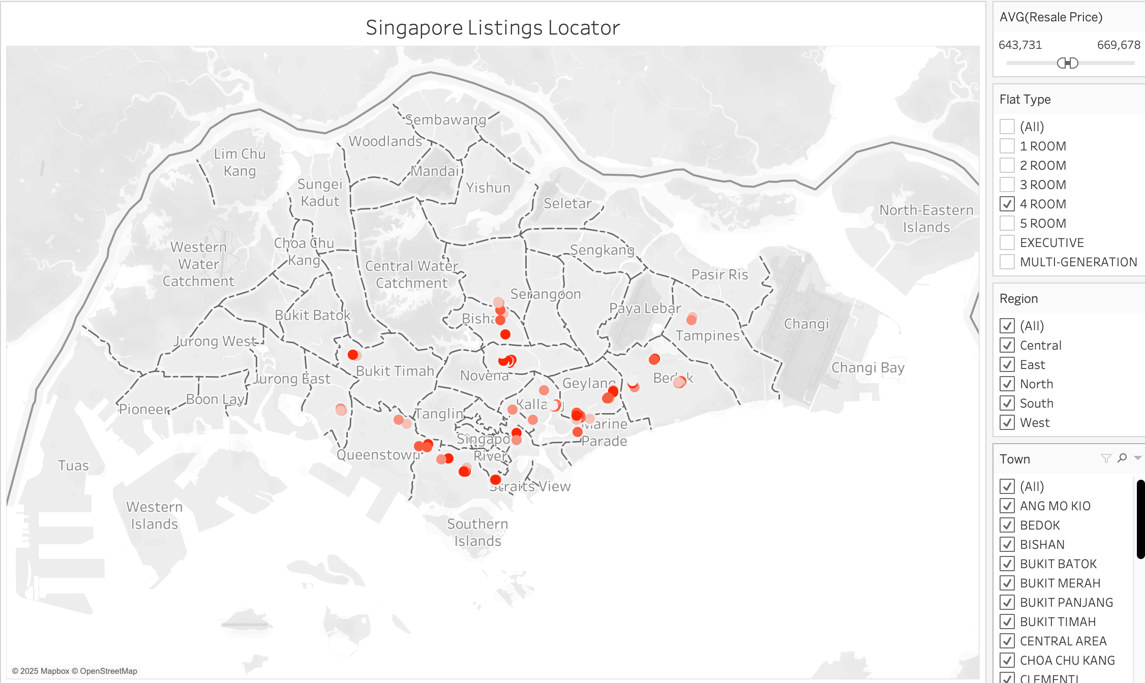
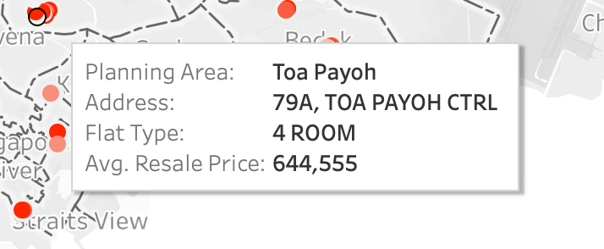
Distribution Map (Prior Transactions)

Slide 9
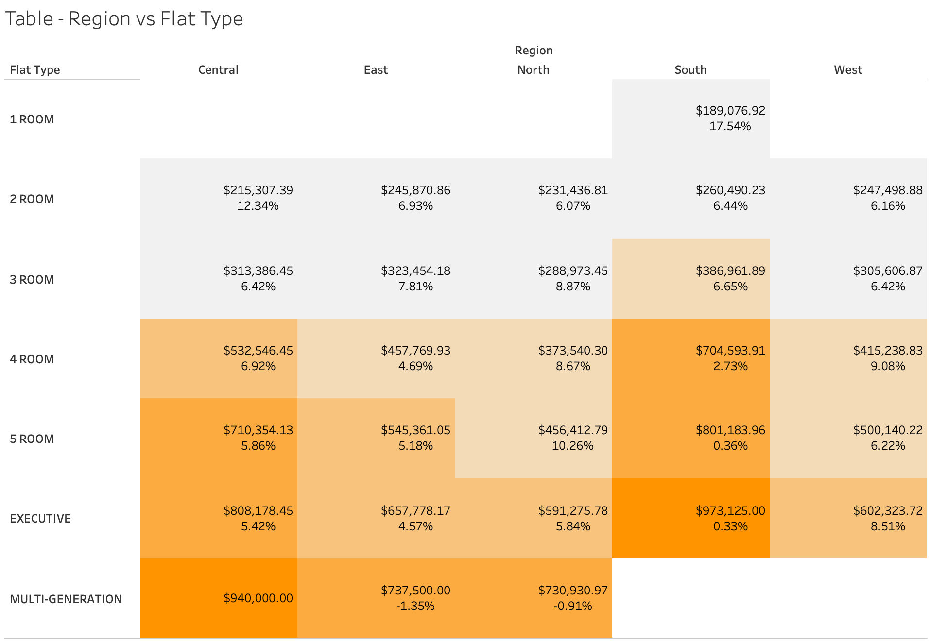
Main Findings (Area Avg Price + YoY Change)

Slide 10
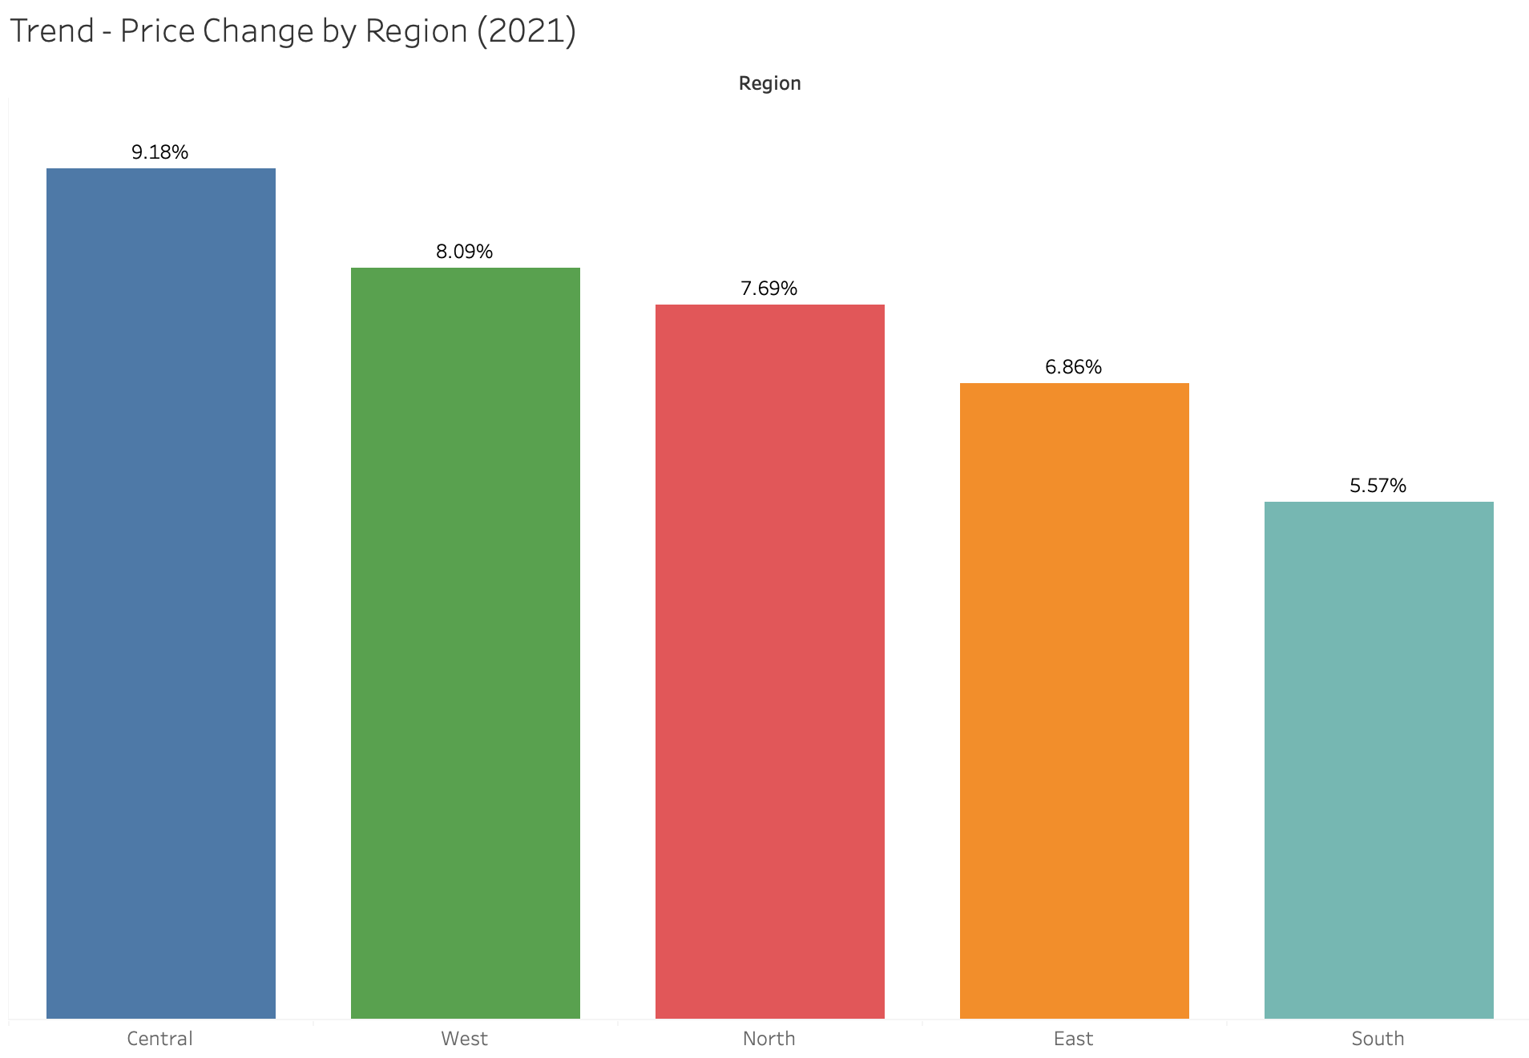
Prior Year Price Change by Region

Slide 11
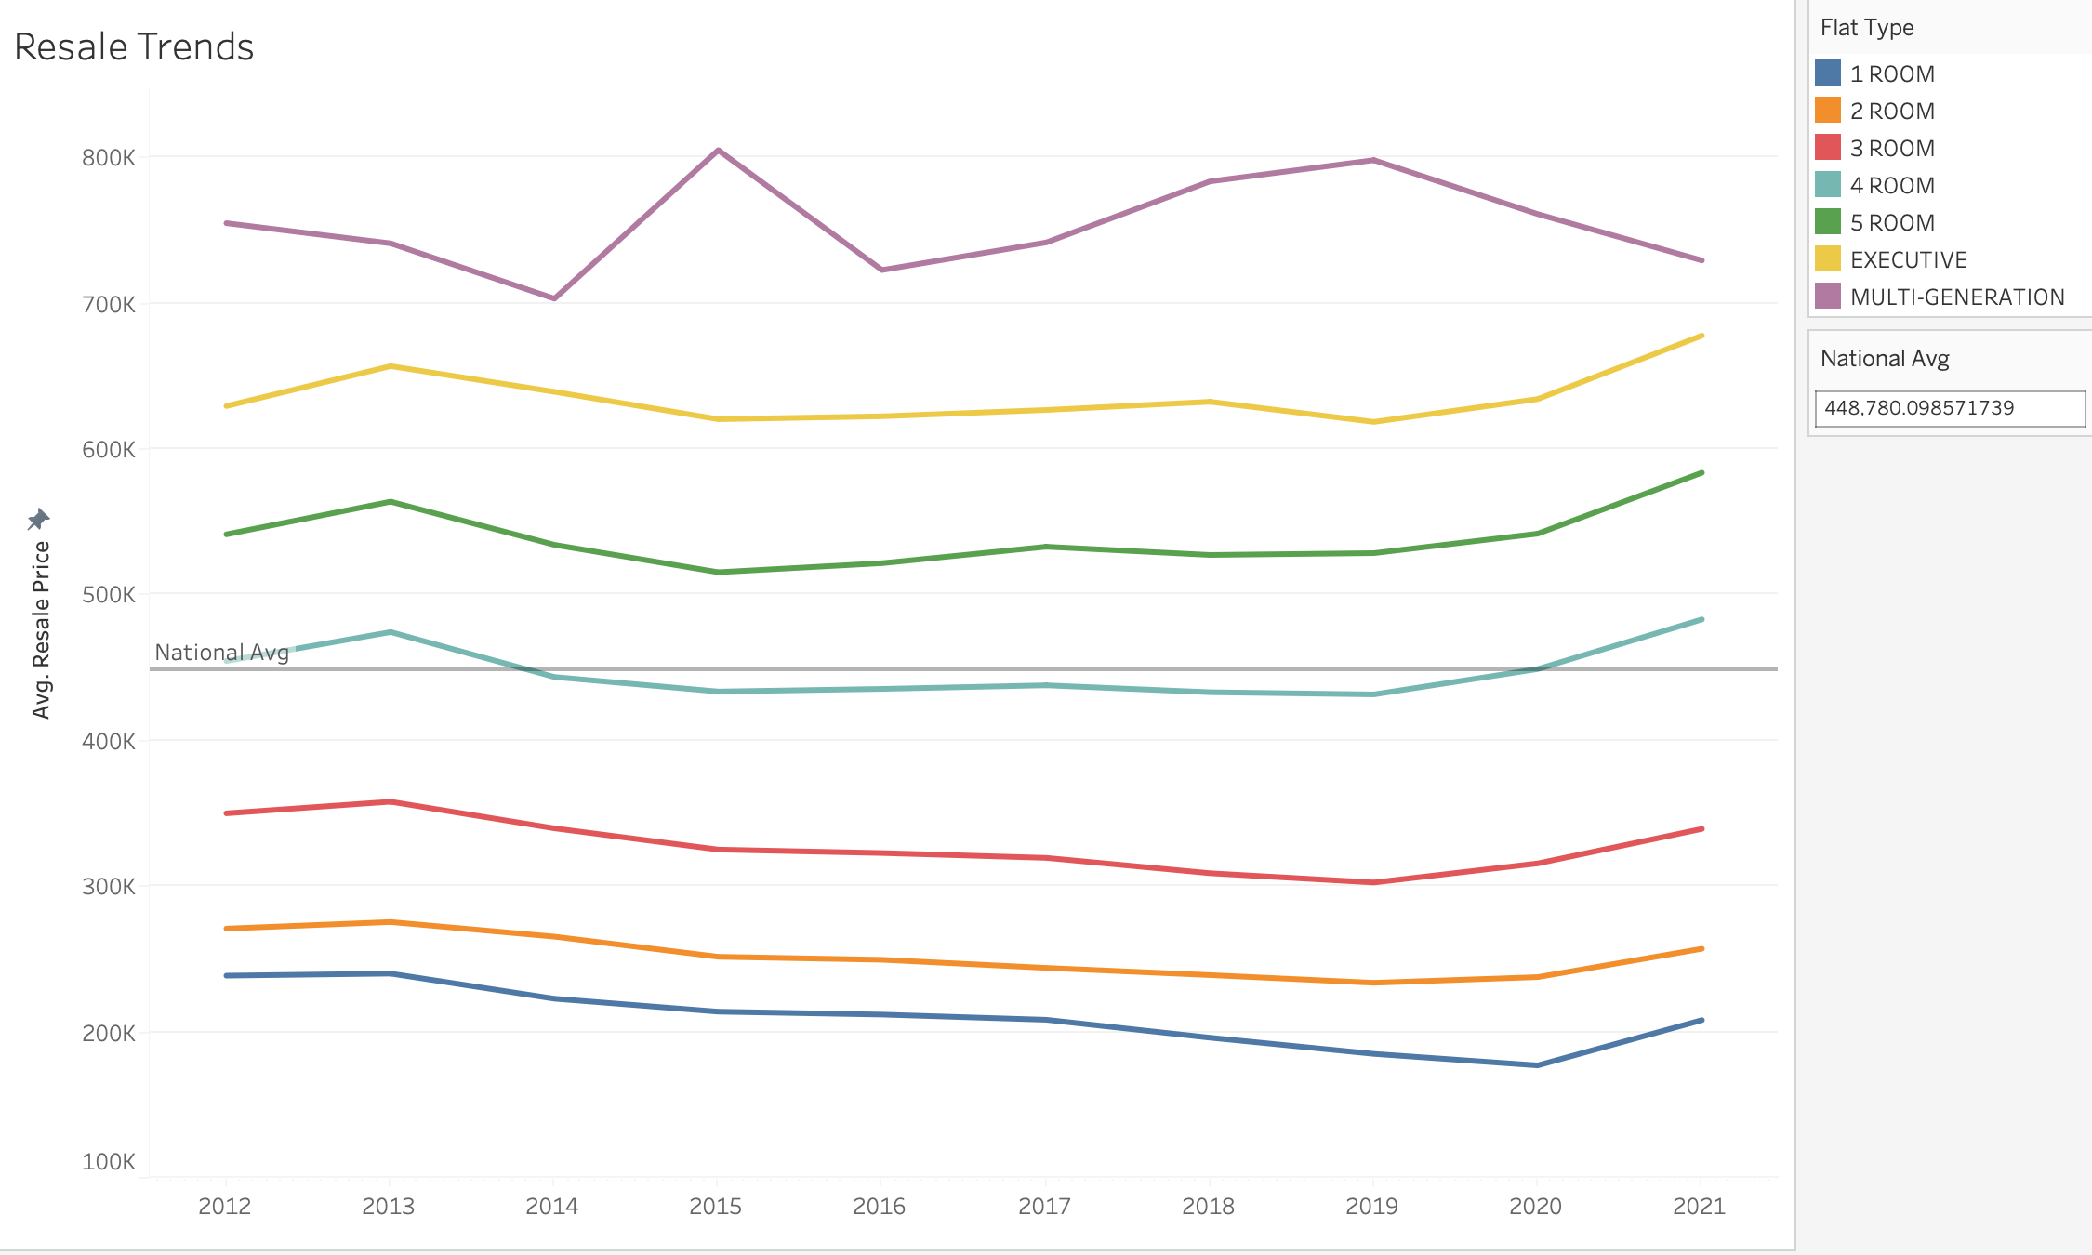
Trends (Resale Price Trend)

Slide 12
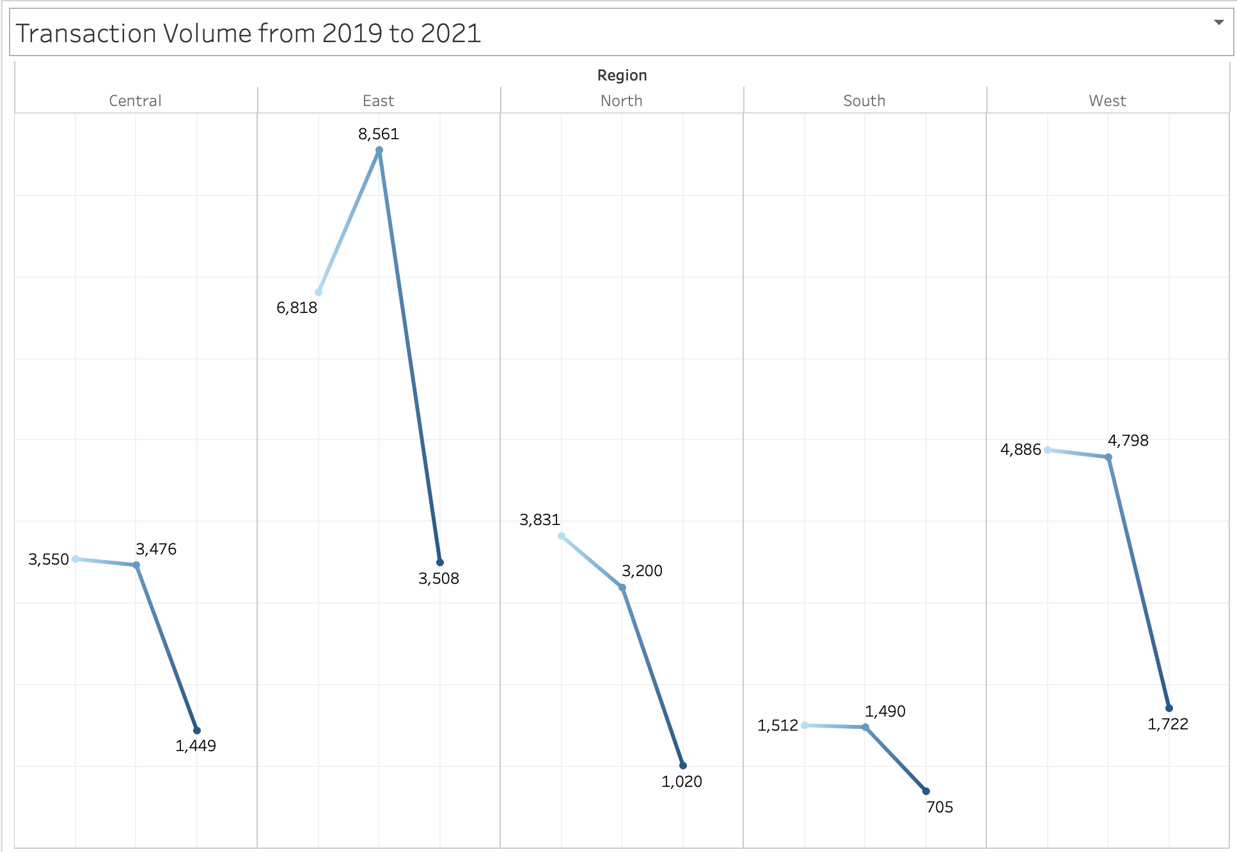
Transaction volume and frequency (Covid)

Slide 13
Demographic Prediction (Next Iteration)
Buyer Profile | Key Flat Types | Location & Amenity Cues | Transaction / Asset Cues
Young Couple | 2–3 ROOM, 3 ROOM | • Near MRT / bus stops (≤ 500 m) • Reasonable distance to malls (≤ 1 km) | • Flat age < 20 yrs
Family | 4 ROOM, 5 ROOM, EXEC | • Within 1 km of a primary school • Within 1 km of a secondary school • Market/hawker within block | • Preference for flats with “multi-storey carpark” & pavilion in precinct
Investor | 2 ROOM, STUDIO, MULTI-GEN | • Close to MRT • Mall within 500 m (for rental appeal) | • Flat age 10–30 yrs (lease midpoint)

Slide 14

Part 1A: Personas

Slide 15

Persona 1 Buyer
Emily & James Tan, First-Time HDB Resale Buyer
Profile: 32-year-old project manager (currently upskilling at GA) with her data science husband, dual-income household, looking to buy a 4-room resale flat in the East Region due to multiple failed BTO attempts. Amenities are very important to them to support their active social life.
Main Questions
Can I afford to wait longer?
Which estates have amenities?
Can I track HDB resale price index to determine if the market is “hot”?

Slide 16
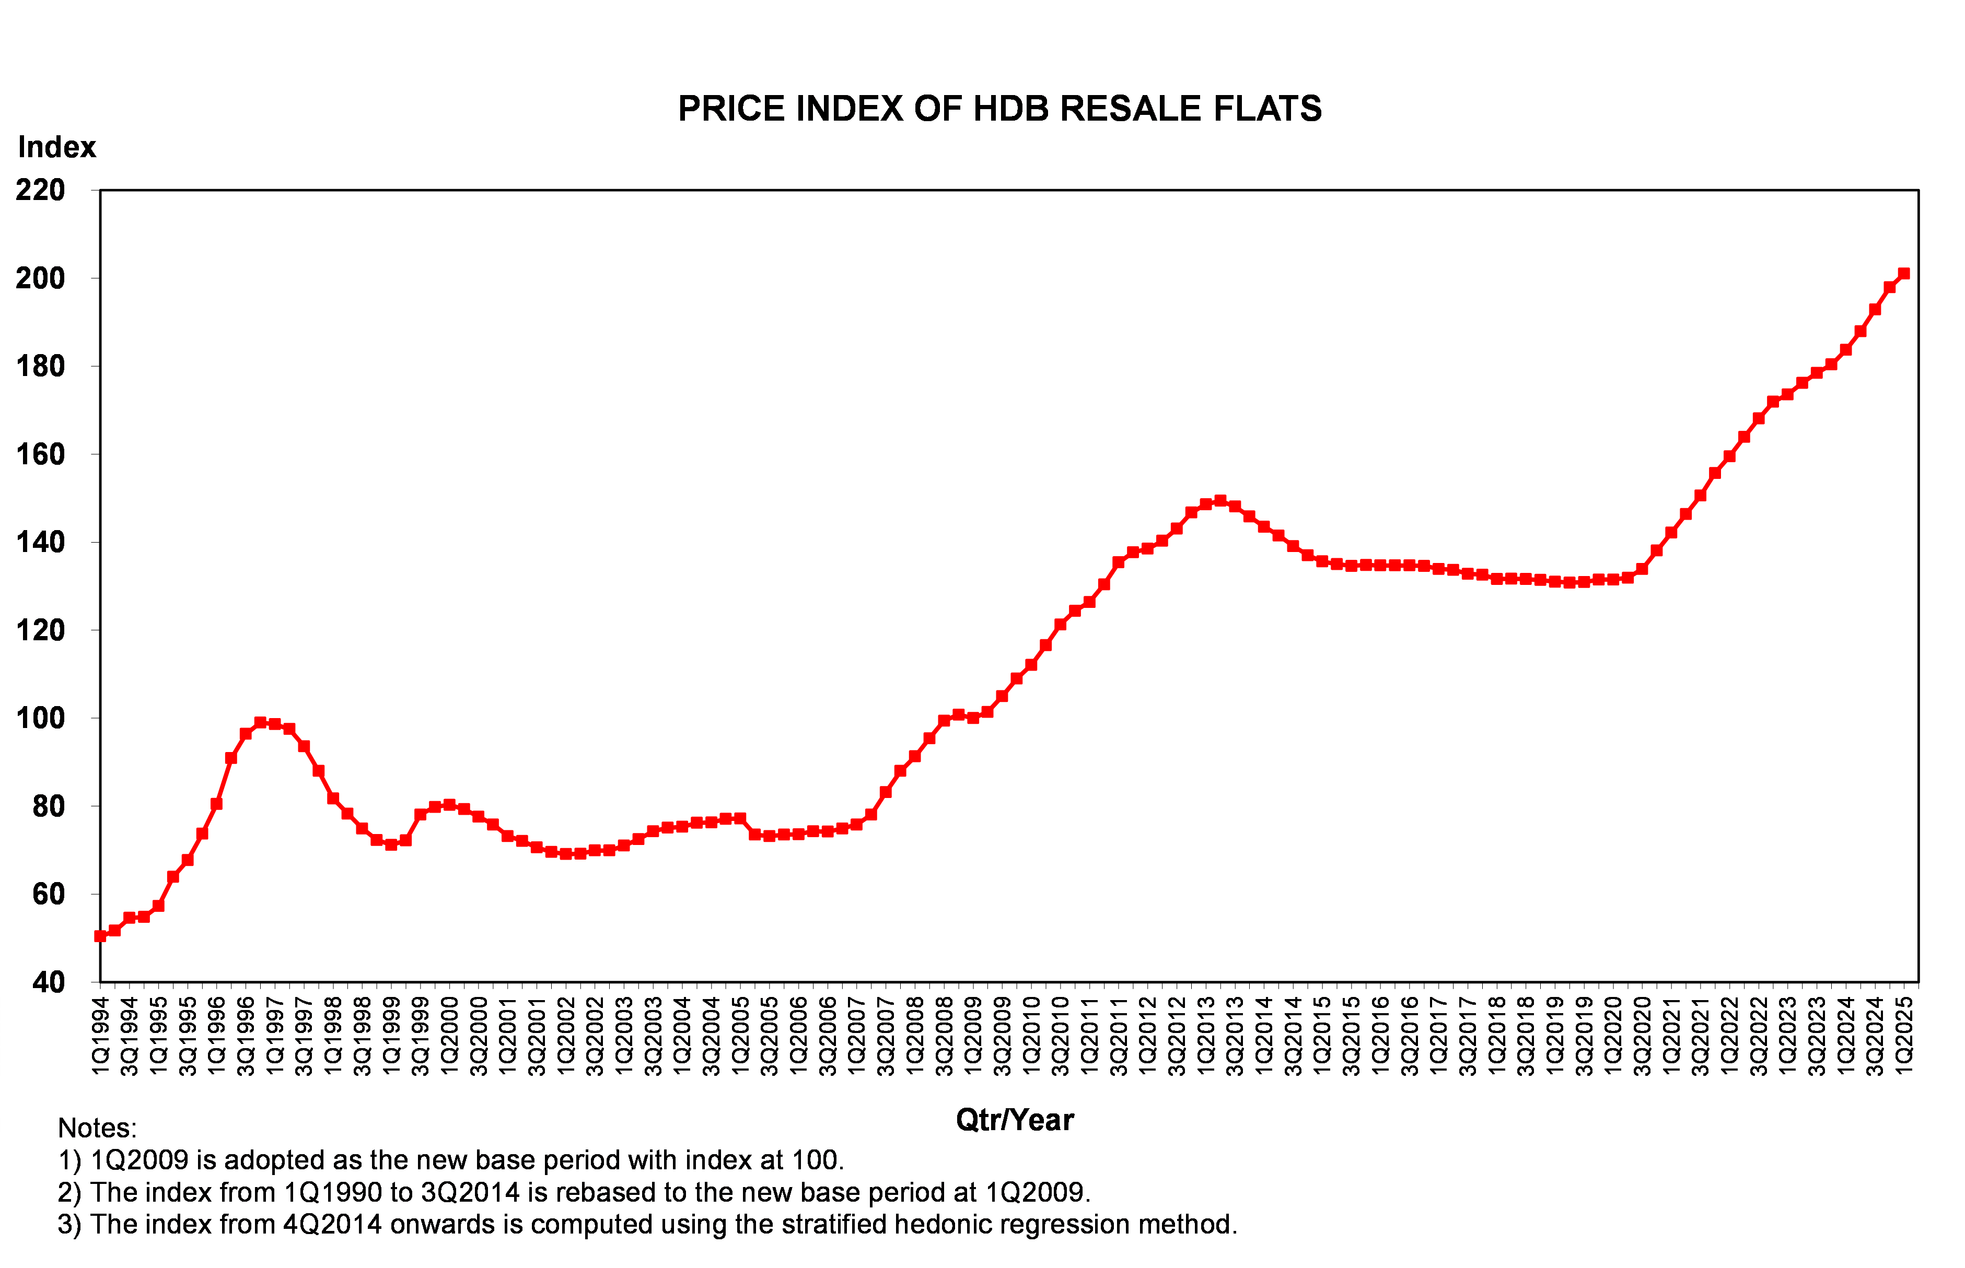
Affordability & Financing
HDB Resale Price Index (HDB)

Slide 17
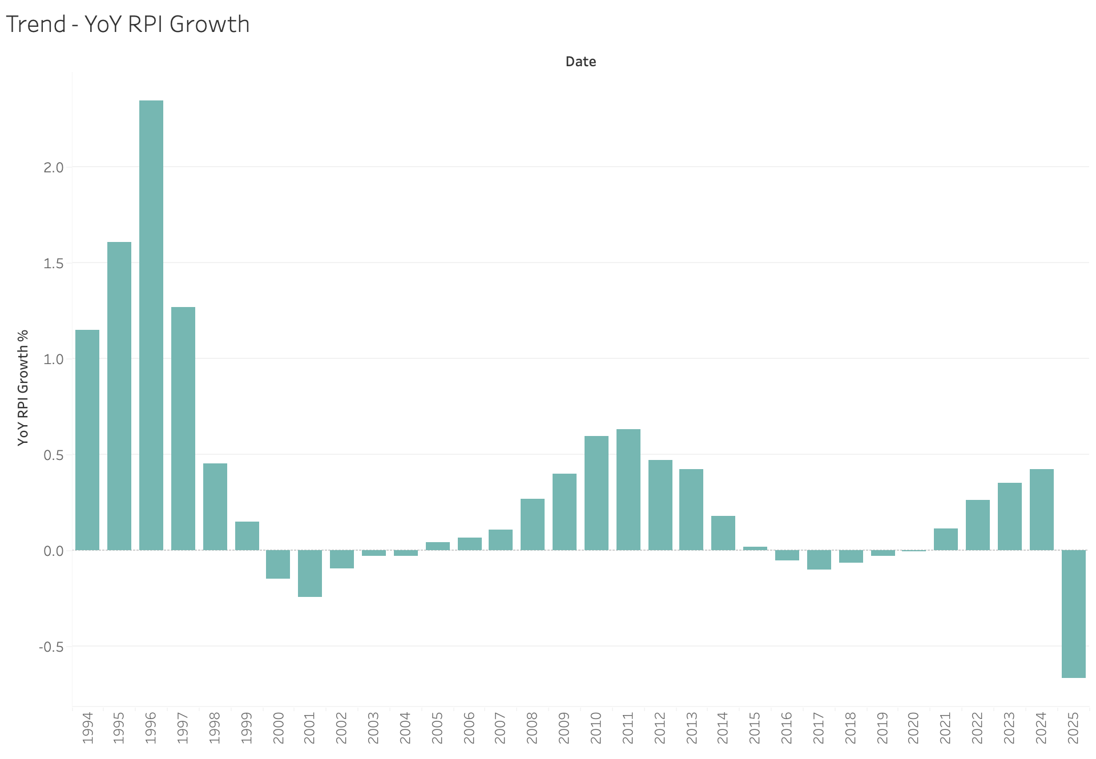
Affordability & Financing
YoY RPI Growth

Slide 18
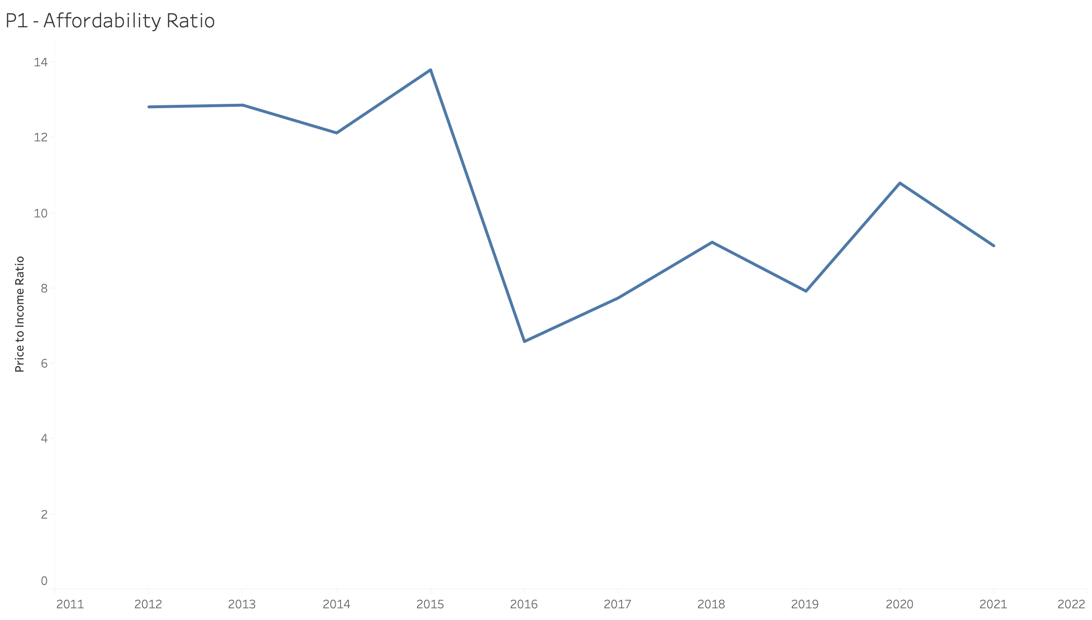
Affordability & Financing
Affordability Ratio (Median HDB Price / Median Income)

Slide 19
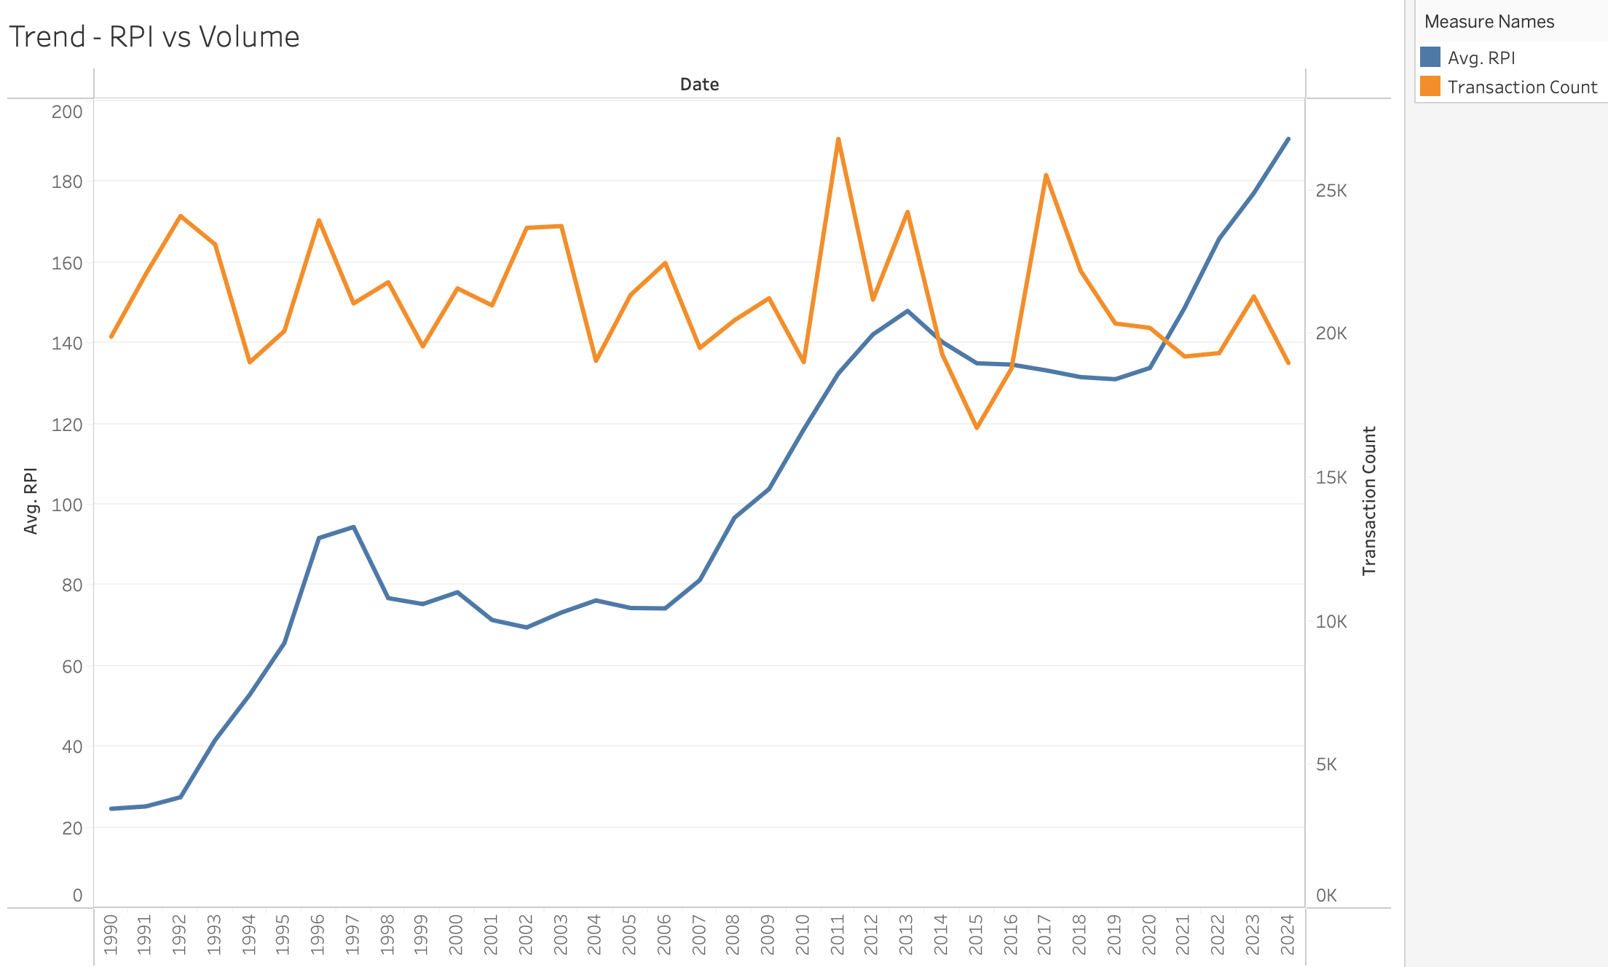
Market Trends & Timing (Lagging Indicator)
Dual-axis line chart showing (a) HDB Resale Price Index and (b) quarterly transaction count

Slide 20
Location & Amenities (Next Iteration)
We want to make a heatmap of amenity density (e.g. number of schools, supermarkets, parks) by HDB town Now we have :

Slide 21

Persona 2 Seller
Mark Hunt, HDB Resale Flat Seller
Profile: 45-year-old single engineer, current owner of a fully paid 5-room flat in Toa Payoh, planning to upgrade to private housing in 2025.
Main Questions
What did people around me price their homes at?
Is it a buyers or sellers market?
When I sell, what kind of extra costs am I looking at to determine my final cash in hand?

Slide 22
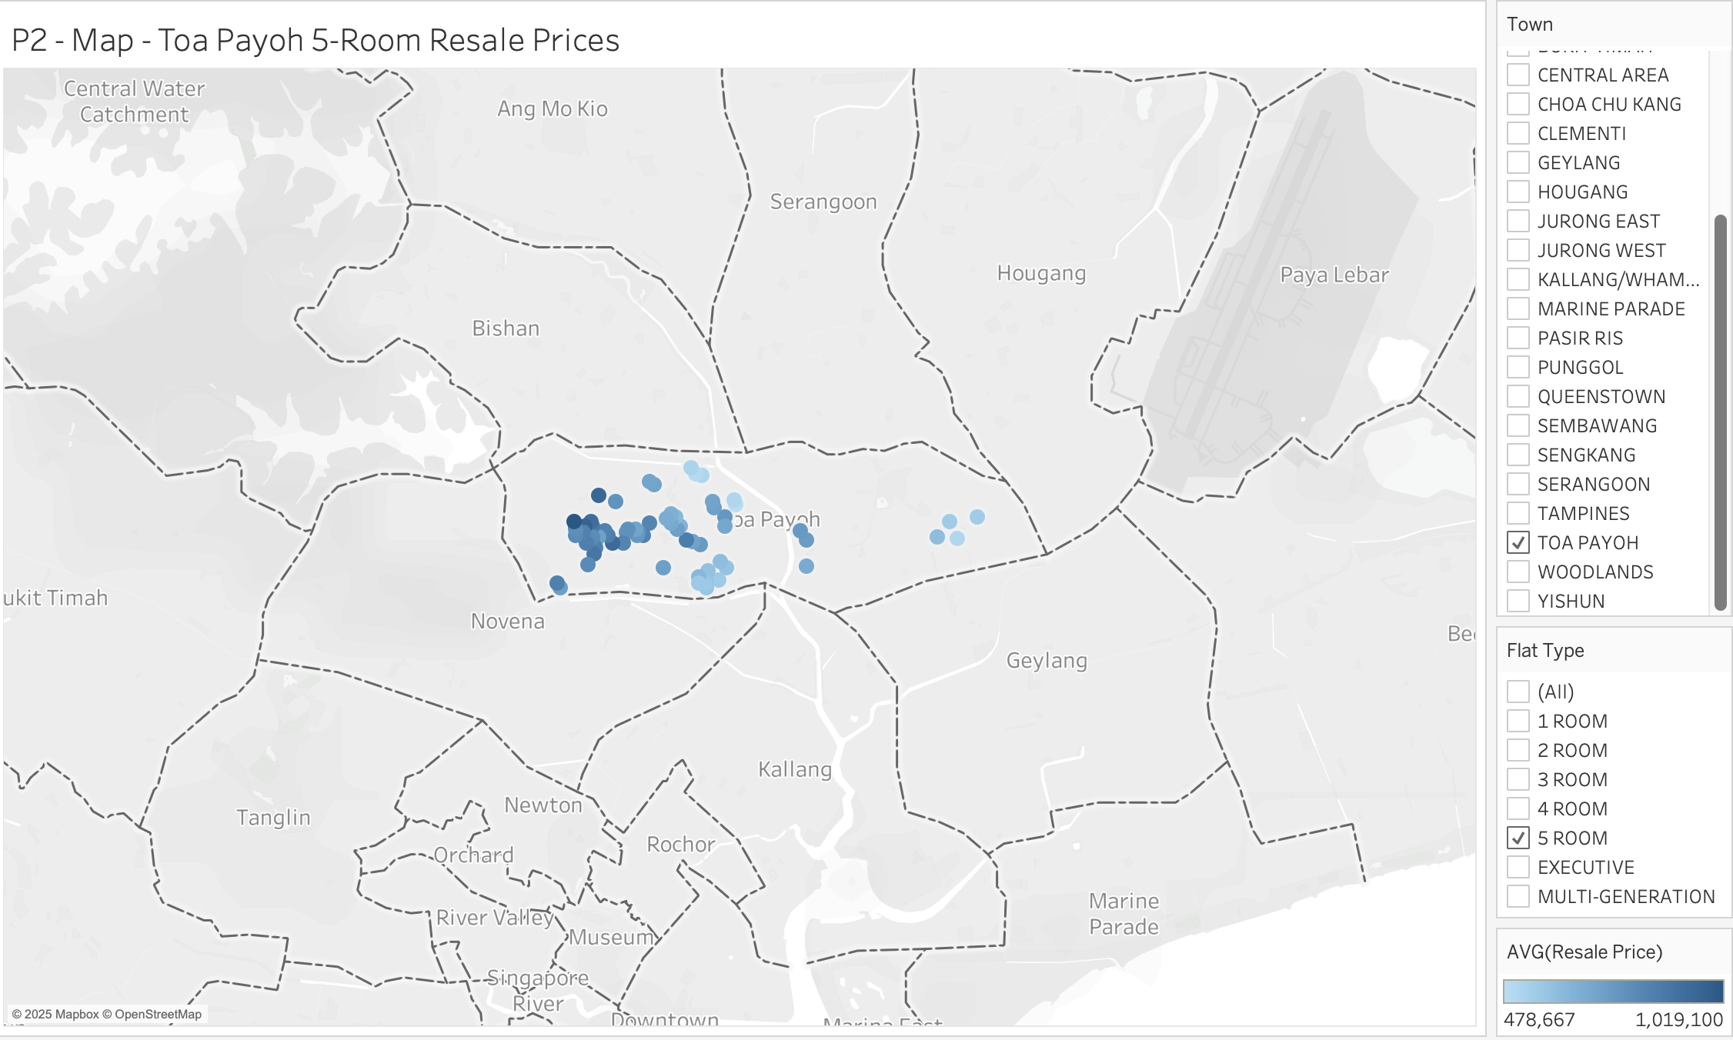
Setting the Right Listing Price
Map of recent transaction prices for the same flat type within a 1 km radius

Slide 23
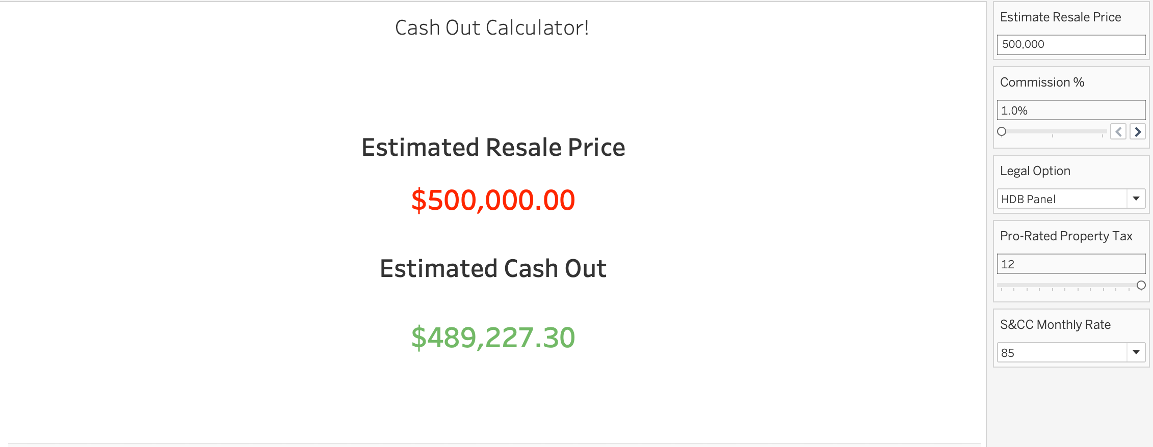
Cash in Hand Calculator

Slide 24
Appendix
1) https://prop.sg/costs-of-selling-property-Singapore\
2) https://coffeebrick.sg/selling-hdb-flat-procedure-ultimate-guide-for-hdb-seller/
3) https://www.99.co/singapore/insider/hdb-service-conservancy-charges/
4) https://adellaw.com.sg/understanding-conveyancing-prices-in-singapore/
5) https://www.iras.gov.sg/taxes/property-tax/property-owners/property-tax-rates

Slide 25
Dataset Download Locations
HDB RSI:
https://data.gov.sg/datasets/d_14f63e595975691e7c24a27ae4c07c79/view
Median Income: https://stats.mom.gov.sg/Pages/IncomeTimeSeries.aspx

Slide 26
Part 2: Research

Slide 27
Dynamics of HDB Market
How strong is the HDB resale market in Singapore?
- Is the HDB resale market a good market to be in?

Slide 28
Headlines
Resale flat prices have risen for 19 consecutive quarters up to Q4 2024 (realestateasia). In 2024, HDB resale prices surged ~9.7% (5% for condos) doubling the ~4.9% rise in 2023 (roncasa). This made HDB resale the best performing housing segment in 2024 for both Owner-Occupier and Investors.
HDB rental yields have been strong in 2022–2024 due to a tight rental market – commonly 3% to 5% gross yield (7-8% rental yield for 3 room HDB flats) (dollarsandsense). These yields far exceed bank deposit rates and can rival REIT dividends.

Slide 29
HDB Resale ROI vs Low Risk Assets (5/10 Year)
Asset Class | Avg Annual Return (5-year) ~2019–2024 | Avg Annual Return (10-year) ~2014–2024
HDB Resale Flat (price appreciation) | ~8% (strong upswing) (Realestateasia.com) | ~3–4% (modest growth)
Fixed Deposit (SGD) 1Y tenor, local banks | ~1.5–2% (low rates until 2022, then ~3%+) | ~1% (near-zero rates in mid-2010s)
CPF Ordinary Account government guaranteed | 2.5% (fixed rate floor) (cpf.gov.sg) | 2.5% (fixed)
Gold (SGD-denominated) | ~11% (bullish period) (goldbroker.com) | ~10% (significant rise)
Singapore Savings Bonds (SSB) | ~2.5% (if redeemed after 5 years)(stepped interest) | ~2.7–2.8% (10-year avg yield)

Slide 30
Impact of Government Policies
Generally how does government policy impact overall resale prices of HDBs?

Slide 31
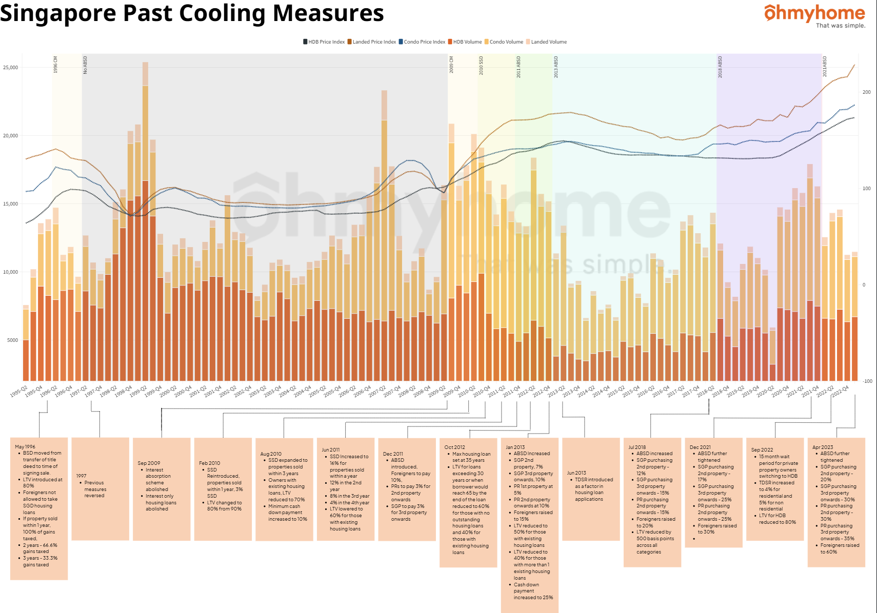

Slide 32
Source and Summary
https://ohmyhome.com/en-sg/blog/singapore-past-cooling-measures/
Timing is key for maximum gains, but generally whenever you buy, no matter what cooling measure was implemented, prices have continued to rise at more than base inflation.
Suggestion: Buy after cooling measures are implemented and hold.

Slide 33
Main Risks of the Resale HDB Market
Regulatory & Policy Risk
Economic Factors and Macro Risks
Lease Decay and Aging HDB Stock
Competition from New BTO Supply

Slide 34
Regulatory & Policy Risk
Active management by government through cooling measures and regulations. (LTV 80%->75%, increase in stamp duties, 15 month wait out rule, “Prime & Plus” BTO.) (DBS)
Rules may change with little notice in response to market conditions.
Mitigate by extra financial prudence to avoid overextending in volatile policy environment.
Understand that interventions may cap price growth / subject to conditions. (CNA)
Agents should prepare sellers for policy-driven volatility.

Slide 35
Economic Factors & Macro Risks
Era of high interest rates (Peak at 4.5% easing to 3%) and high inflation. “Higher for longer” (CNA). Increasing higher monthly loan payments and higher costs of living.
Singapore has low unemployment now which is good for housing demand, but any global downturn can affect this.
Agents should advise buyers to stress test finances with conservative interest rate assumptions and possibly locking in fixed rates.
Patient sellers can time market exits in periods of lower interest rates for better valuations. (Sgluxurycondo)

Slide 36
Lease Decay & Aging HDB Stock
HDBs are depreciating assets in the very long run. Government has made it clear that not all old flats will get redevelopment offers. (TodayOnline)
Flats with less than 60 years of lease face restrictions on CPF funding and loans.
Agents should caution buyers about attractive older resale flats and lease decay risk and that exit strategies could be compromised. They may need to sell by a certain date.
Sellers of older flats should be advised about the risks of staying in the market for too long without pricing competitively to secure a sale.

Slide 37
Competition from New BTO Supply
Competition from new BTO flats is an important dynamic. 21,225 new flats launched in 2024, and Q4 2024 resale volume dipped. (CNA)
No immediate crunch due to Plus / Prime flats only hitting the market 10 years later. (Ministry of National Development)
Buyers should weigh time vs cost. As more attractive BTO locations are heavily oversubscribed. However, they can afford to be patient as increased BTO supply should be a stabilizing factor to reduce runaway resale prices.
Sellers of older flats should keep on top of MOP expirations in certain towns and price competitively to sell before that happens.

Slide 38
Sources
1) https://www.dbs.com.sg/personal/articles/nav/my-home/cooling-measures-in-singapore
2) https://www.channelnewsasia.com/singapore/hdb-resale-prices-rise-2024-96-private-housing-ura-2023-4834546
3) https://www.channelnewsasia.com/singapore/mas-financial-stability-review-household-banks-company-debt-levels-4773171
4) https://sgluxurycondo.com/impact-of-interest-rate-on-singapore-property-prices/
5) https://www.todayonline.com/big-read/big-read-hdb-lease-decay-govts-solutions-not-perfect-theres-light-end-tunnel
6) https://www.mnd.gov.sg/our-work/housing-a-nation/bto-classification

Slide 39
Part 3: Technical

Slide 40
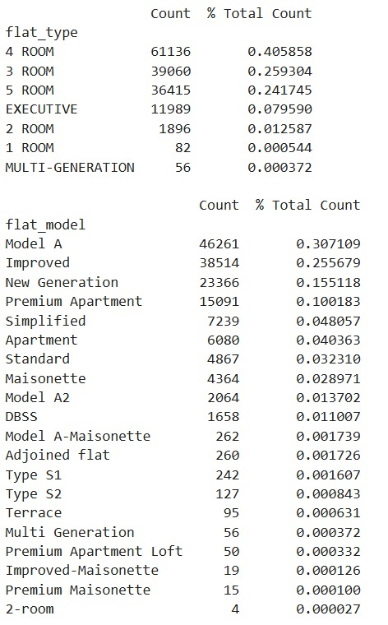
Data Wrangling
One Hot Encoding:
'planning_area’
'flat_model’
'flat_type’
Column Used:
'id’
'flat_type’
'floor_area_sqm’
'flat_model’
'resale_price’
'hdb_age’
‘planning_area’
'Mall_Nearest_Distance’
'Hawker_Nearest_Distance’
'mrt_nearest_distance’
'pri_sch_nearest_distance'
“Others”
“Others”

Slide 41
Model Selection (Performance – Base Model)
Model | R² | RMSE | MAPE
Linear Regression | 0.866 | 52,245.9 | 9.19%
Random Forest | 0.919 | 40,728.2 | 7.53%
XGBoost | 0.921 | 40,013.9 | 7.42%
ElasticNet | 0.662 | 82,897.6 | 13.06%
GAM Spline + LR | 0.731 | 74,025.7 | 11.84%

Slide 42
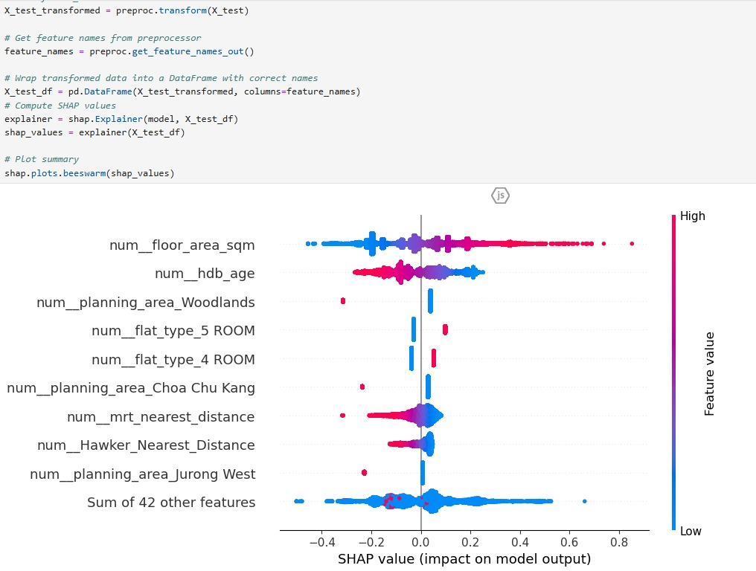
Interpretability by SHAP (Shapley additive explanations)

Slide 43
Model Selection (S / W, Linear Regression)
Strengths | Weaknesses
Simplicity & Speed: Fast to train and predict, minimal hyperparameters. | Linearity Assumption: Struggles when relationships are nonlinear or there are complex interactions.
Interpretability: Coefficients map directly to feature effects on the (log) price. | Outlier Sensitivity: Even with log‐transforms and clipping, extreme prices can unduly influence weights.
Baseline Benchmark: Gives you a clear “floor” performance to improve upon. | Limited Flexibility: Cannot automatically capture feature interactions unless you engineer them.

Slide 44
Model Selection (S / W, Random Forest)
Strengths | Weaknesses
Nonparametric Flexibility: Captures arbitrary nonlinearities and interactions without explicit feature engineering. | Less Interpretable: Hard to explain individual predictions; feature importances are aggregate only.
Robust to Outliers & Noise: Uses bagging and averaging to stabilize predictions. | Compute & Memory: Can be heavy with hundreds of trees and high‐dimensional one‐hot features.
Built‐in Importance: Permutation or impurity‐based importances help identify key drivers. | Overfitting Risk: Deep trees can overfit if not properly pruned or limited in depth. (A fully grown tree can memorize every nuance (even noise) of its training sample—perfect accuracy in-sample, but poor performance on new data.)

Slide 45
Model Selection (S / W, XGBoost)
Strengths | Weaknesses
State‐of‐the‐Art Accuracy: Often outperforms RF by sequentially correcting residuals. | Hyperparameter Sensitivity: Needs careful tuning of learning rate, tree depth, subsample rate.
Handles Heterogeneous Data: Works well with mixed numeric/categorical, missing values. (You can throw in numeric, ordinal, even label-encoded categoricals without elaborate one-hot pipelines.) | Longer Train Times: Boosting can be slower than bagging, especially with large grids.
Regularization: Built‐in L1 (lasso) /L2 (ridge) penalties reduce overfitting. | Opaque Predictions: Like RF, individual‐tree interactions are hard to convey to agents.

Slide 46
Argh! Too slow!
n_jobs = -1 (Uses all cores available)
from sklearn.ensemble
import RandomForestRegressor
model = RandomForestRegressor(n_jobs=-1)
Reduced our random forest computation time from 20 mins down to 10

Slide 47
Model Selection (S / W, Elastic Net)
Strengths | Weaknesses
Feature Selection: The L1 (“lasso”) component zeroes out weak predictors, simplifying the model. | Still Linear: Cannot capture nonlinear patterns without manual feature expansions.
Collinearity Handling: The L2 (“ridge”) term stabilizes correlated features better than pure lasso. | Requires Standardization: Numeric features must be scaled identically, and categorical expansions can bloat dimensionality.
Interpretability: Retains linear form, but with sparse coefficients. | Tuning Needed: Optimal l1_ratio and alpha require cross‐validation.

Slide 48
Model Selection (S / W, GAM Spline + LR)
Strengths | Weaknesses
Structured Nonlinearity: Automatically fits smooth curves for each numeric feature (via splines) while retaining additivity. | Limited Interactions: By default, additive (no pairwise interactions) unless explicitly included.
Partial Dependence = Visual Interpretability: You can plot each feature’s spline to show its marginal effect on log‐price. | Spline Tuning: Number & placement of knots can affect performance and must be chosen carefully.
Balance of Flexibility & Simplicity: More flexible than linear but still less prone to overfitting than full tree ensembles. | Computation: Fitting many basis functions on large data can be slower and memory‐intensive.

Slide 49
Model Selection (Summary)
If you need razor‐sharp accuracy and are comfortable with a “black box,” go with XGBoost (tuned) or Random Forest.
If you need clear, per‐feature explanations for agents, stick with Elastic Net or Linear Regression (possibly augmented with engineered features).
For a middle ground—smooth nonlinear trends but still transparent effects—the GAM spline + linear approach is often the best compromise.

Slide 50
Model Selection
Simple Linear Regression: Works best when you have a handful of predictors, they’re roughly independent, and you believe their effect on the target is (approximately) constant per unit change.
Use it when your data is simple, relationships are roughly linear, and you want maximum interpretability (“every extra dollar in ad spend boosts sales by $X”).
Elastic Net: Works best when you’ve got dozens—or hundreds—of potentially correlated features and you need automated feature selection plus stability.
Use it when you have lots of predictors (some redundant) and you want a data-driven way to zero in on the ones that matter most—without overfitting.
Generalized Additive Model: Captures non-linear effects (e.g. diminishing returns) while still additive (so interactions only if you explicitly add them).
Use it when you suspect the effect of a predictor isn’t perfectly straight (maybe it levels off or accelerates) but you don’t want a fully black-box model: you still want to visualize and explain each predictor’s shape.

Slide 51
Model Selection (When to use)
Model | When to use?
Linear Regression | Obvious features, roughly independent, data is simple, only numerical ( Want to use what I learn in GA)
Random Forest | Accuracy, don’t need to come up with coefficients, can be numerical / categorical (Want to get better RMSE than laoshi)
XGBoost | (Even more) Accuracy, don’t need to come up with coefficients, can be numerical / categorical, needs hyper tuning (Want to get better RMSE than everyone and low-key competitive on the best accuracy, min-maxer bro)
ElasticNet | Linear regression but you have dozens / hundreds of features (Want to find out which features are actually important because show off pick a data set with tons of features)
GAM Spline + LR | Linear regression but you have some non-linear relationships (When your boss tells you to use linear regression on a problem that is clearly non linear but wants it to be interpretable by non technical people)

Slide 52
Model Selection (Linear Regression)
Our top goal is interpretability, ability to show rationale and usage by agents, so we select: Linear Regression

Slide 53
Part 4: Retrospectives

Slide 54
Lessons
Spend more time in the planning step, craft out the mission, what is really required, the personas and what you think the “answer” may look like.
Ask yourself what does “Success” look like, are we aiming for interpretability? “Best” model performance, accuracy, RMSE, MAPE? Or a blend of both? If we are aiming for just 1 thing, what would it be?
Delegate tasks and responsibilities cleanly and leave enough buffer time for things to go wrong and for others to step in when needed.

Slide 55
Lessons (What we did well)
Good time management and planning allowed us buffer of time when things did not go as planned.
We delegated tasks effectively so each person’s strengths could shine through and function as an efficient team.
Move fast break fast fix fast.

Slide 56
Lessons (What we could have done better)
Could have locked in faster on our objectives, or have a solid “make or break” deadline for certain key decisions for example, if nothing better than linear regression could be found, then to use linear regression.
Spent more imaginary free time studying and improving our data skills so that we could have gone into this project with a much deeper knowledge base.

Slide 57
Q&A

